Slide 1
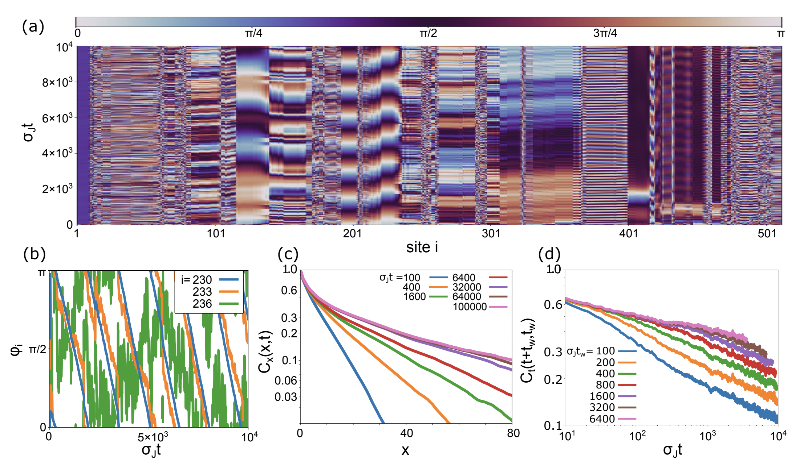

Slide 2
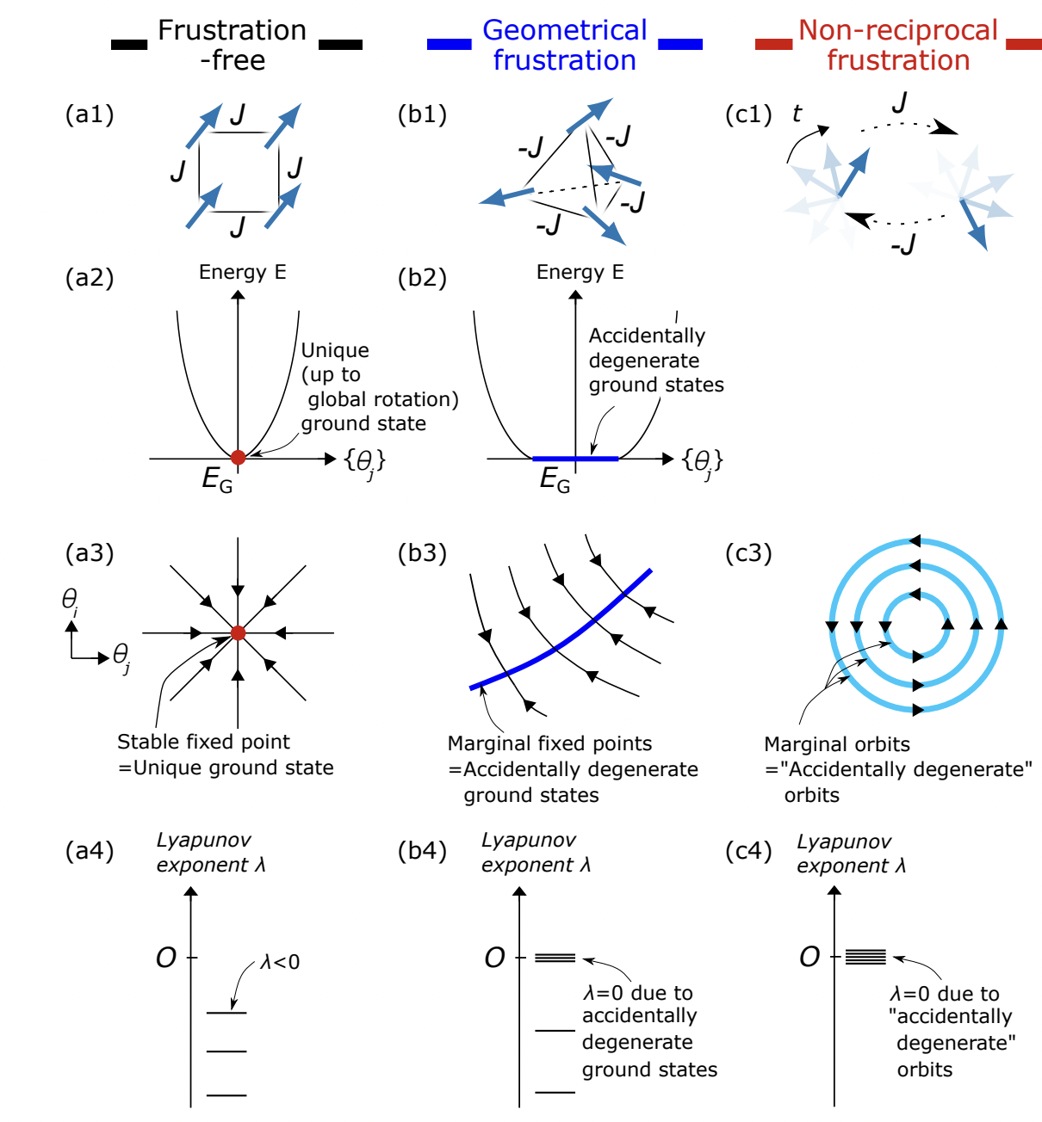

Slide 3
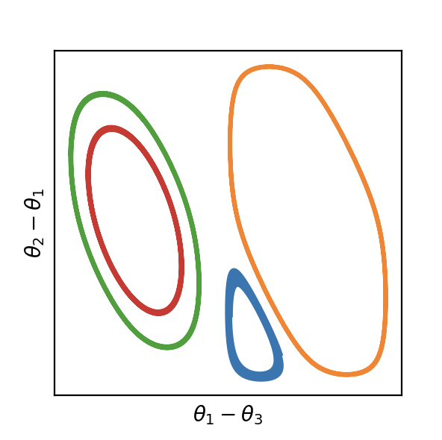
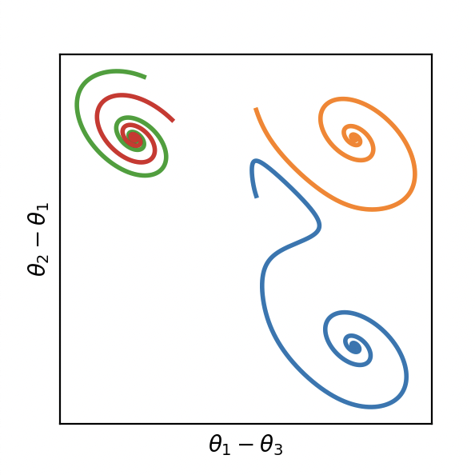
(a)
(b)

Slide 4
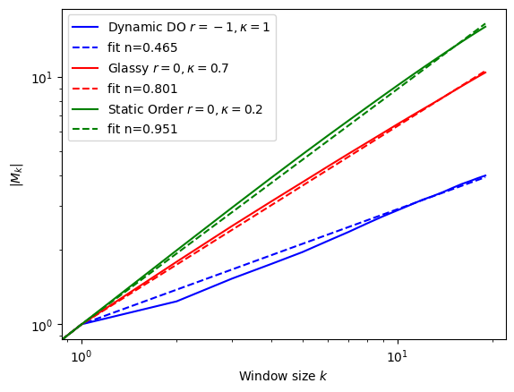

Slide 5
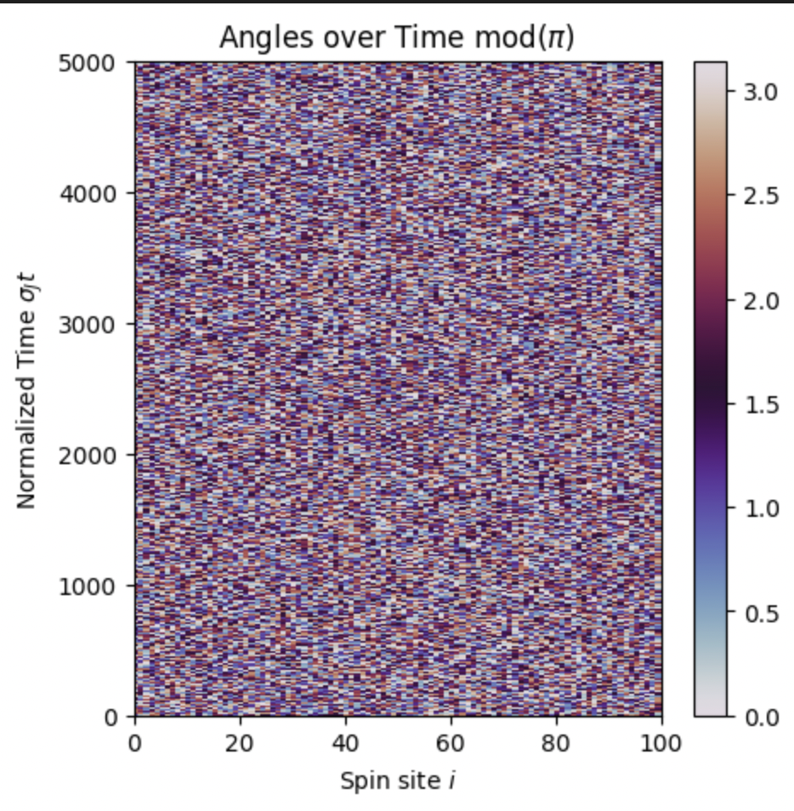
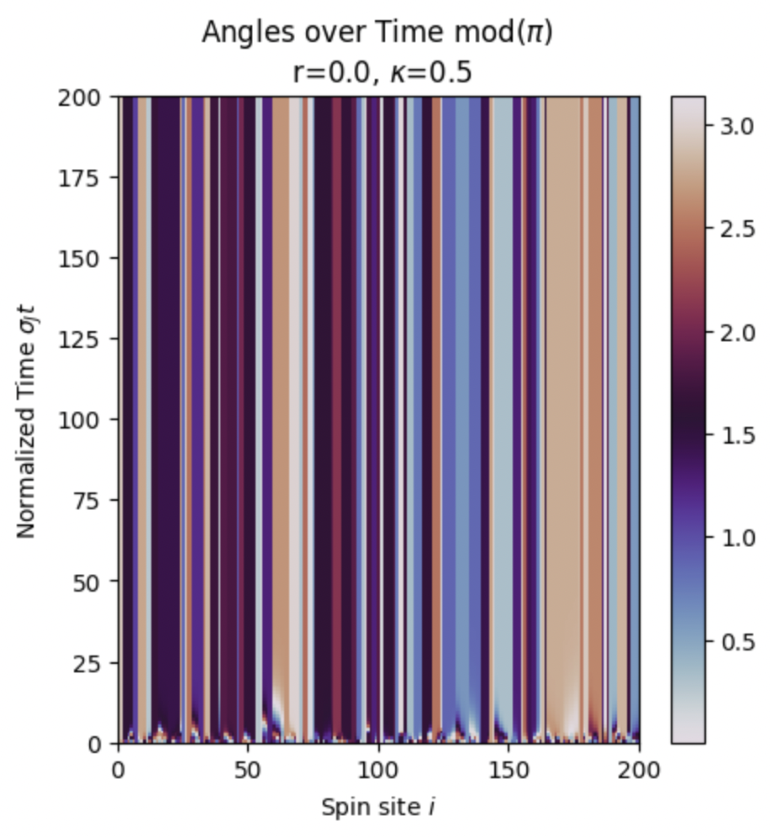
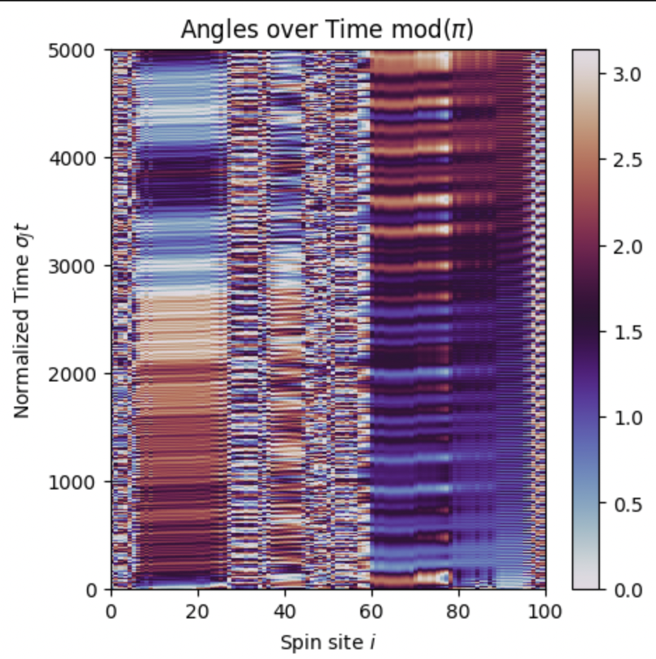
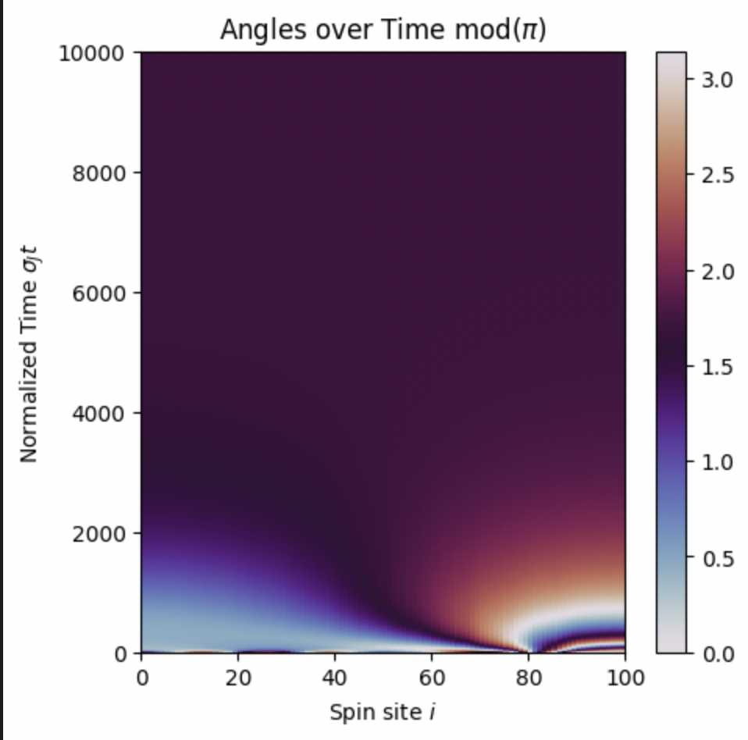
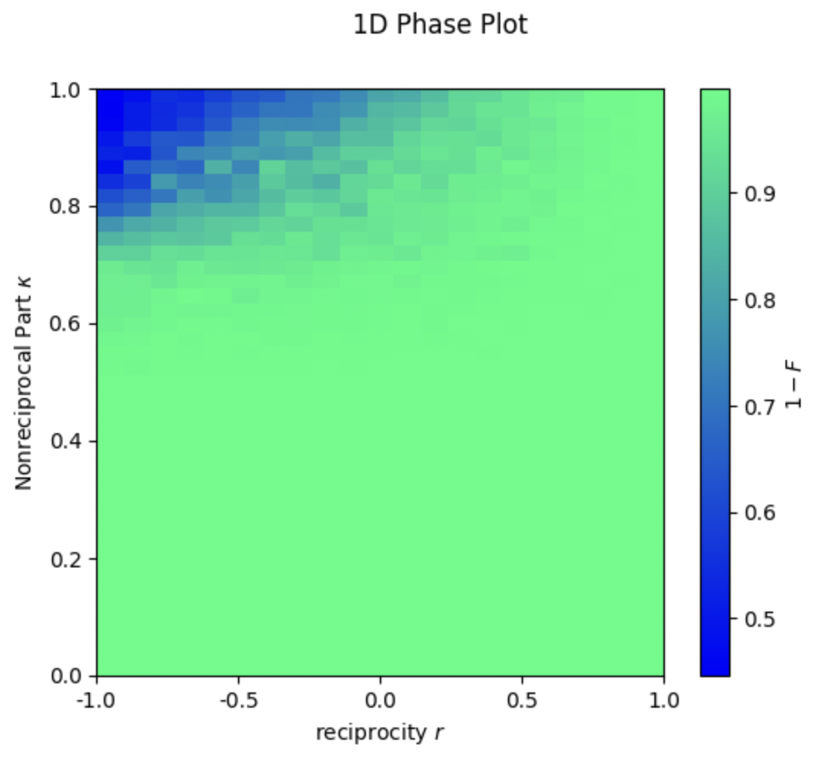
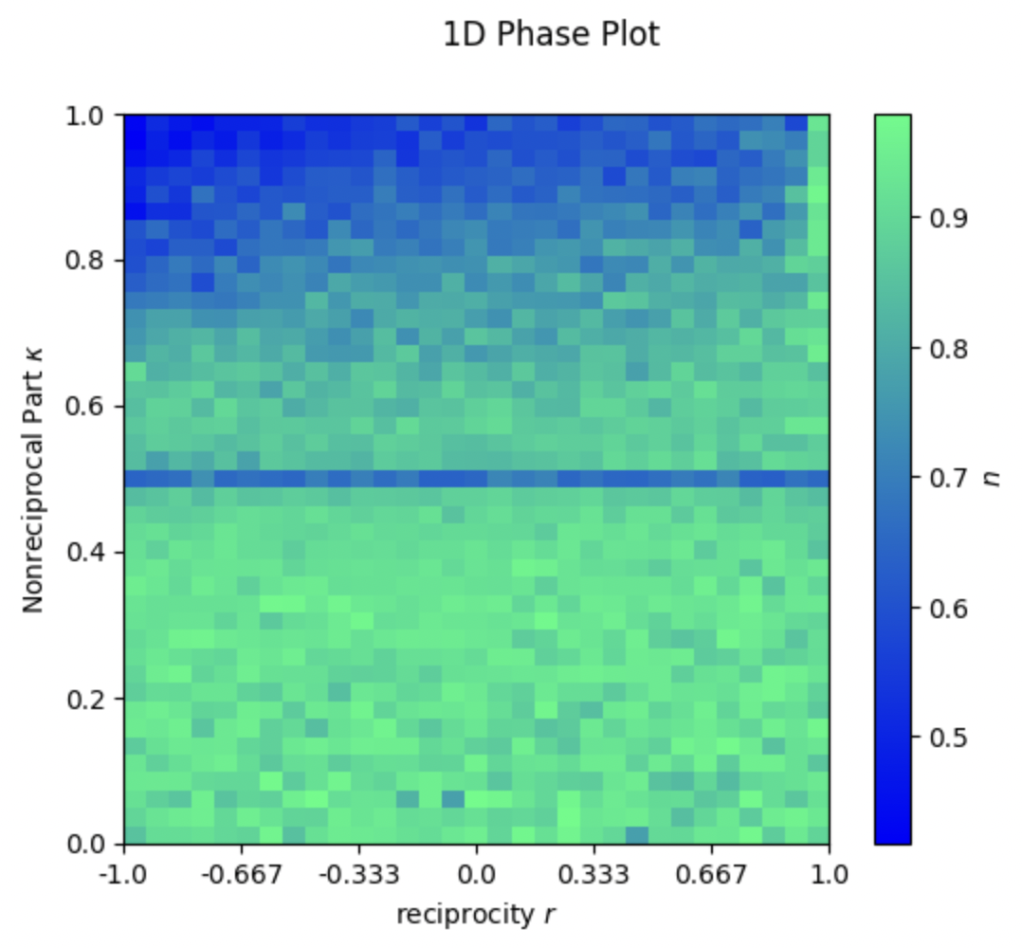
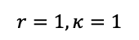
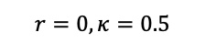
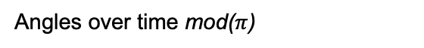
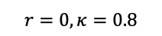
Angles over time mod($π$)
(b.1)
(b.2)
$$r=0, κ=0.5$$
(b.3)
$$r=0, κ=0.8$$
(b.4)
$$r=−1, κ=1$$
$$r=1, κ=1$$
(a)
d=1 Phase Diagram
Dynamic DO
Static
Nematic
LRO
Glassy
Frozen DO
(c.1)
Temporal Order
(c.2)
Spatial Order
Static Polar LRO

Slide 6
Static Nematic LRO
+
-
-
-
+
-
-
-
κ
Glassy
+
-
+
+
-
+
+
+
Frozen DO
+
+
+
r
+
+
+
Polar LRO
+
+
+
+
+
+
+
+

Slide 7
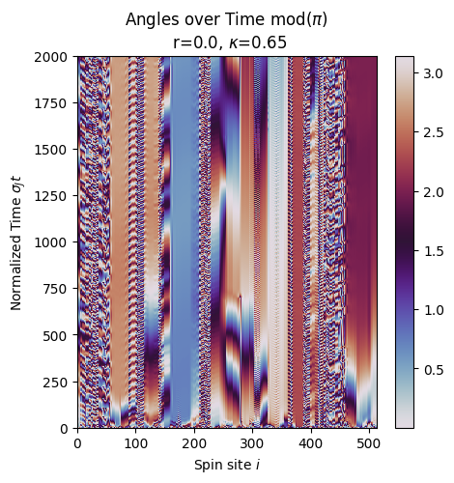
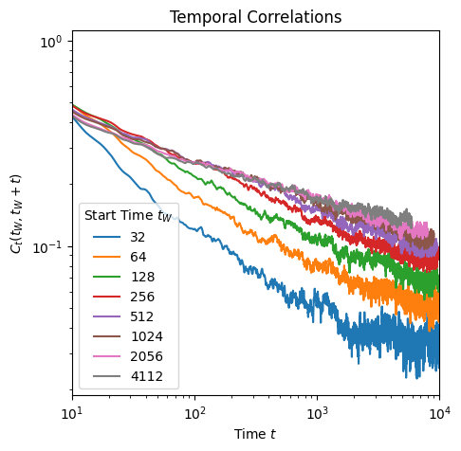
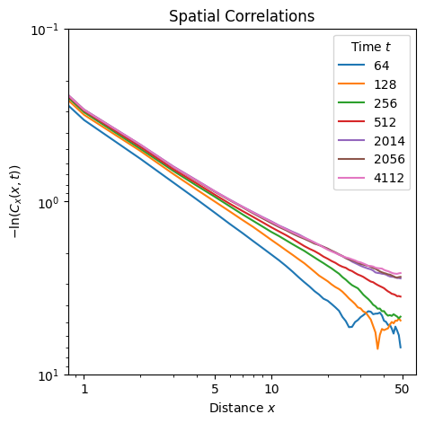
(a)
(b)
(c)

Slide 8
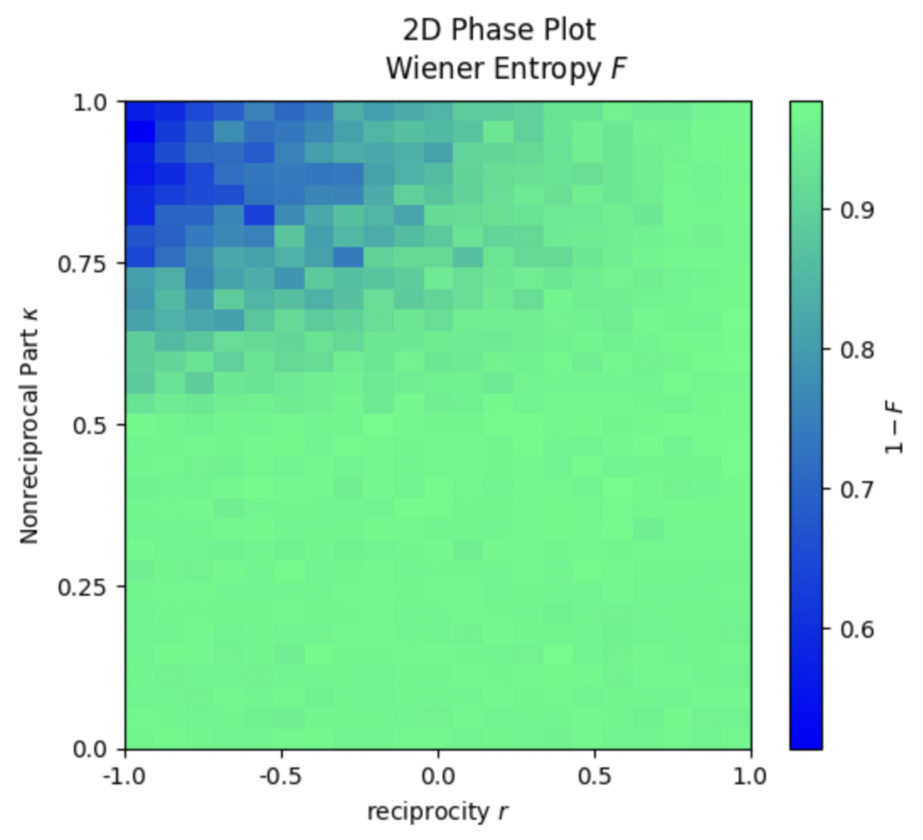
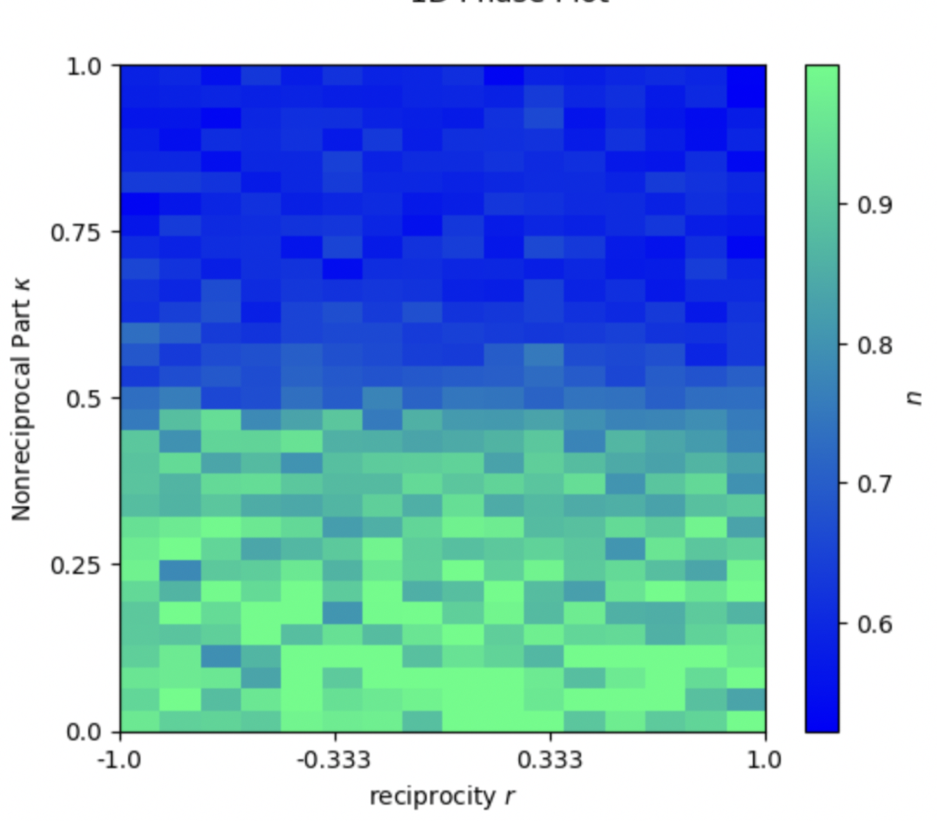
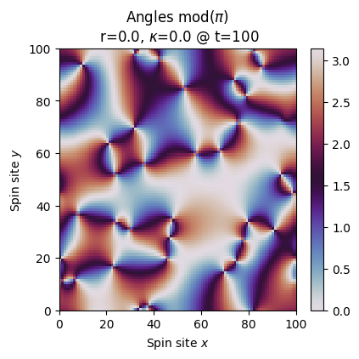
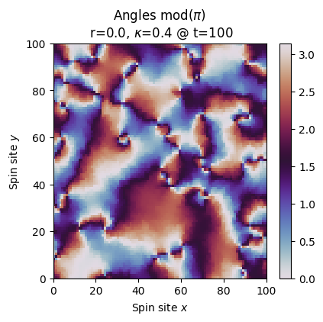
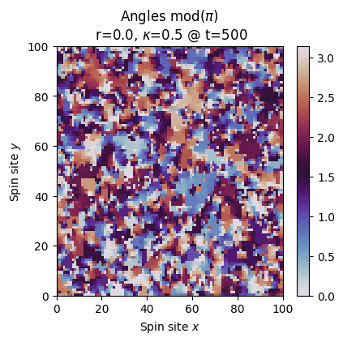
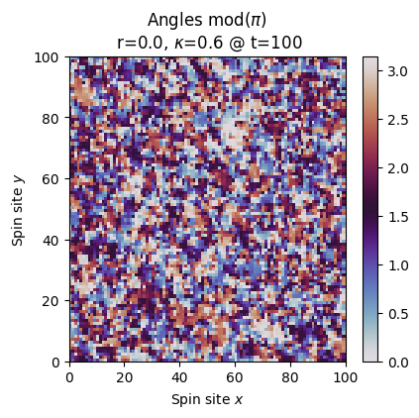
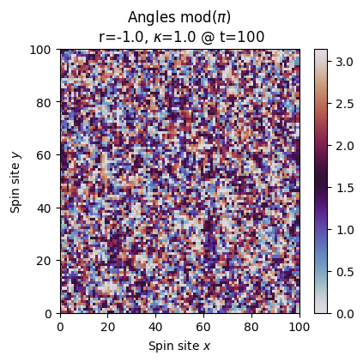
(a)
d=2 Phase Diagram
(c.1)
Temporal Order
(c.2)
Spatial Order
Dynamic DO
Static DO
Static Polar LRO

Slide 9
(a)
d=2 Phase Diagram
(b.1)
Temporal Order
Dynamic DO
Static DO
Static Polar LRO
(b.2)
Spatial Order

Slide 10
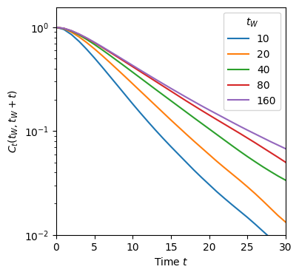
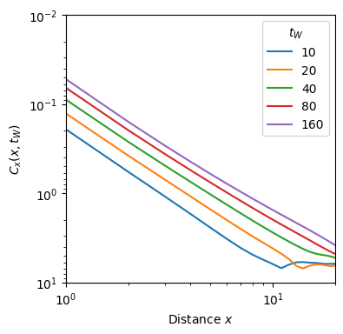
(a)
Temporal Correlations
(b)
Spatial Correlations
-ln( )
Exponential Fit
Stretched Exponential Fit

Slide 11
-
+
+
+
-
+
-
Geometric Frustration
+
+
+
-
NR Frustration
+

Slide 12
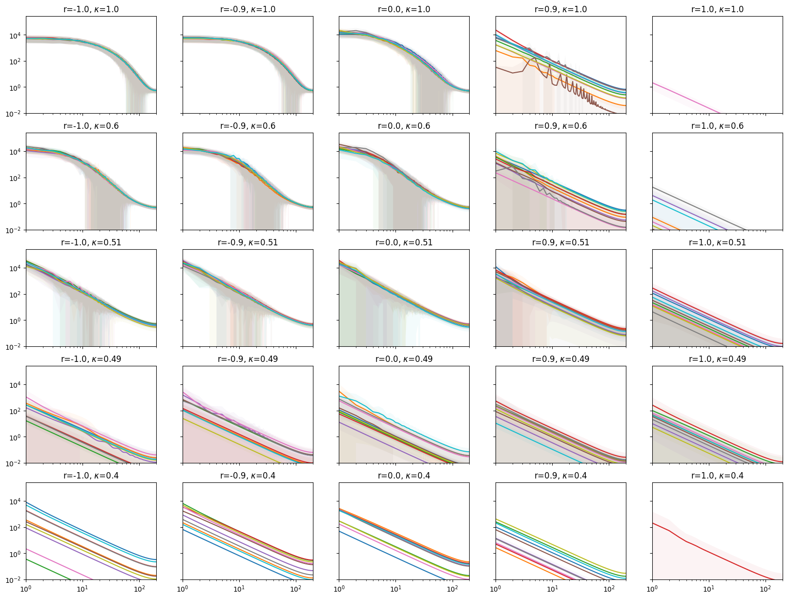
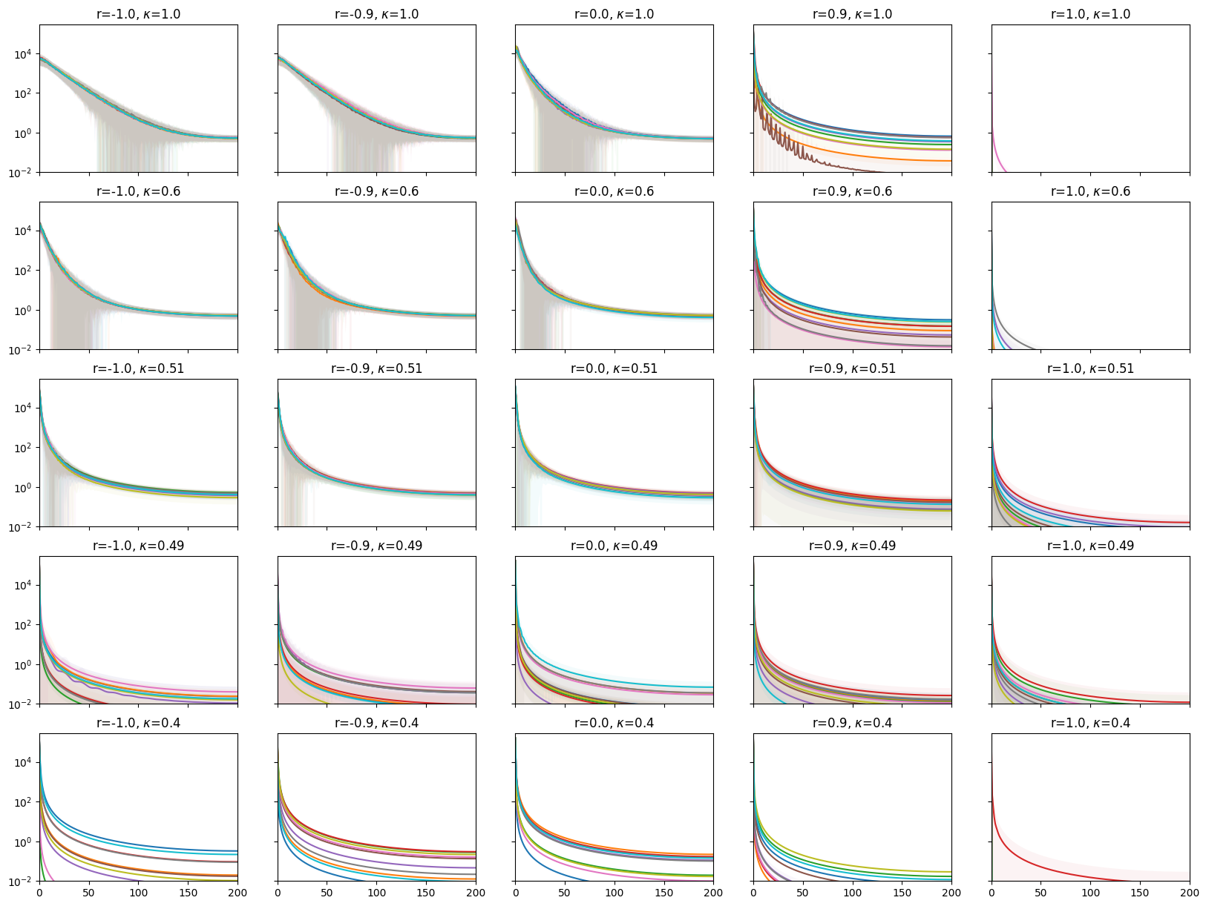
Power Spectra
Square Amplitude
Frequency

Slide 13
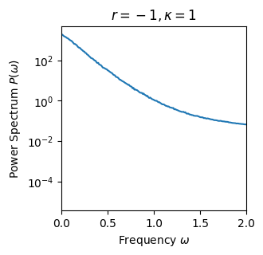
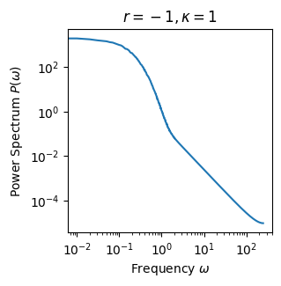
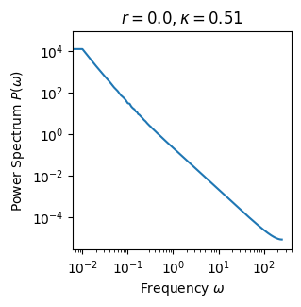
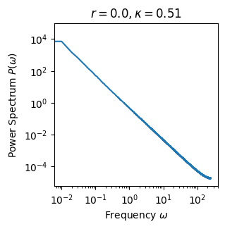
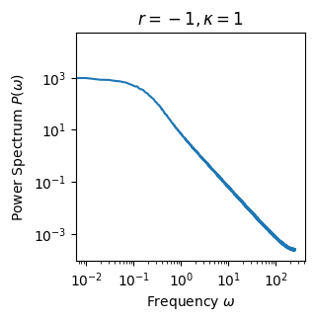
(a)
(b)
Exponential
Power Law
Power |F(f)|²
Const
Frequency f
Frequency f (log)
(a)
(b)
Power Law
Power Law
Exponential
(a)
(b)
Exponential
Power Law
Const

Slide 14
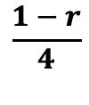
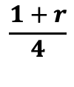
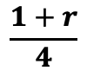
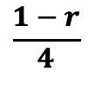
A
B
Probability
$$\frac{1+r}{4}$$
$$\frac{1−r}{4}$$
$$\frac{1−r}{4}$$
A
B
$$\frac{1+r}{4}$$

Slide 15
A
C
B

Slide 16
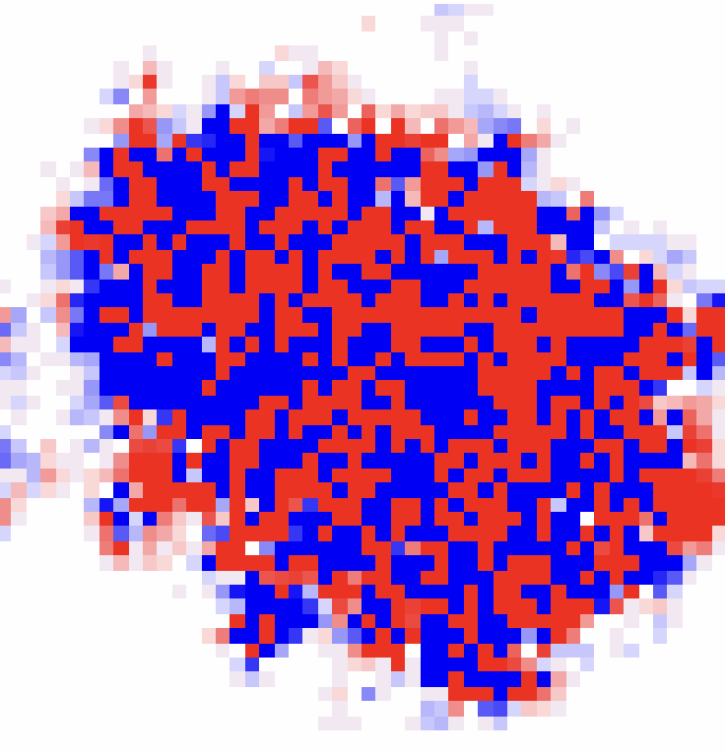
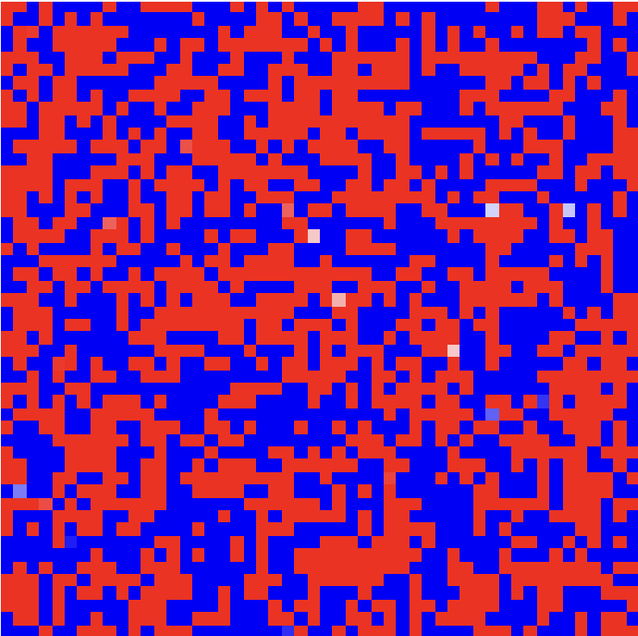
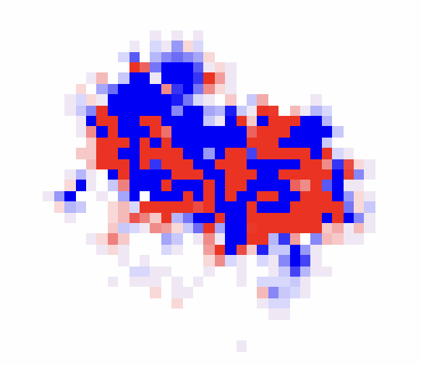

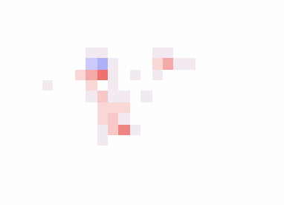
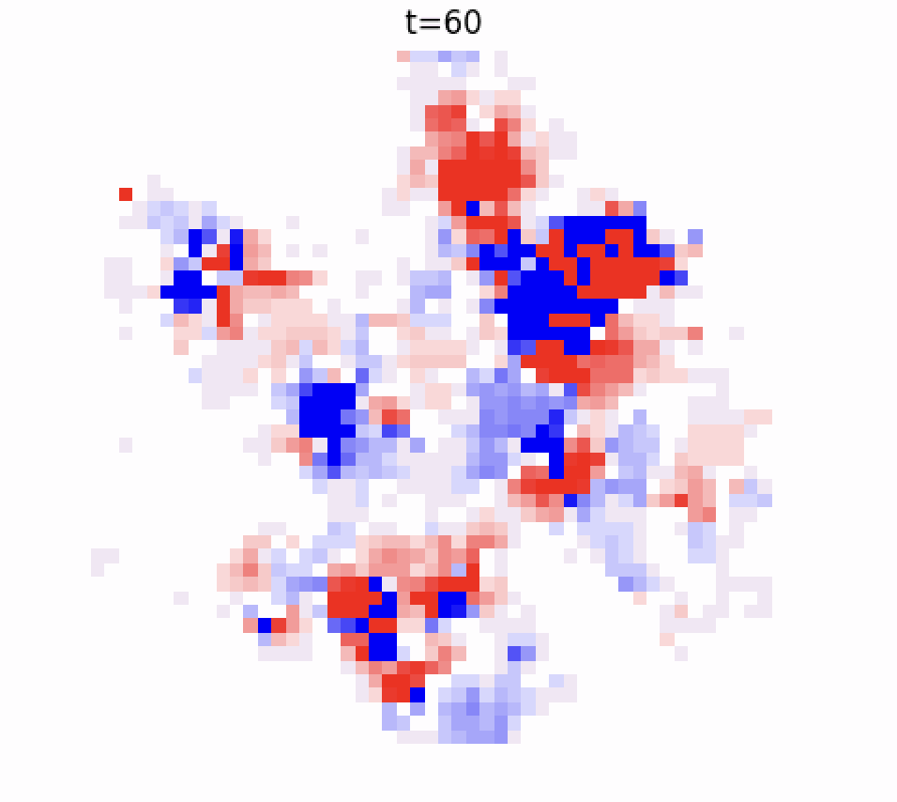
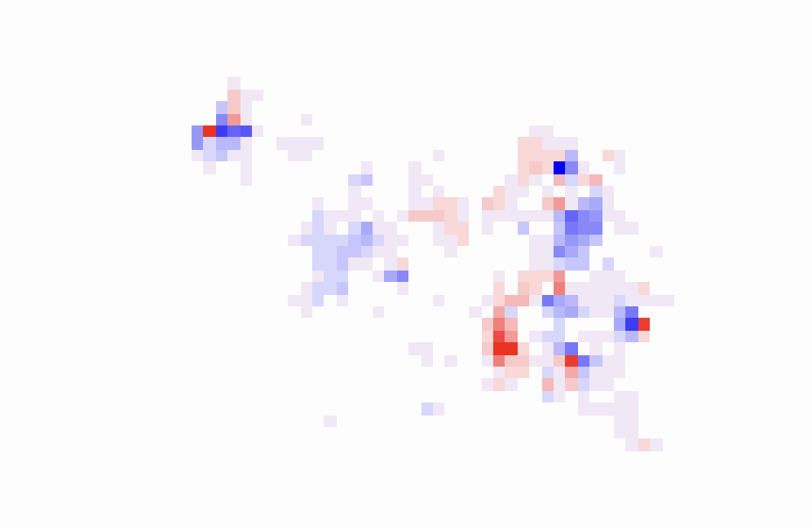
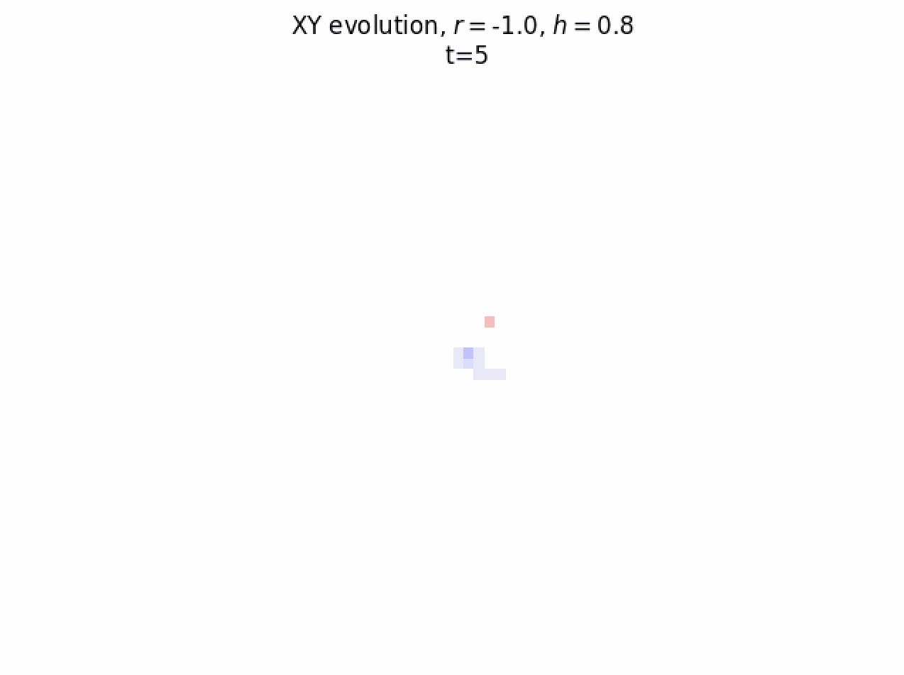
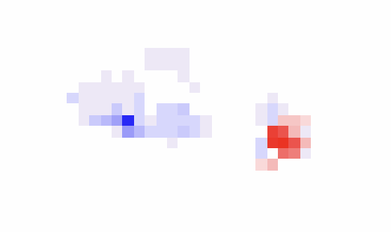
(a)
t
(b)

Slide 17
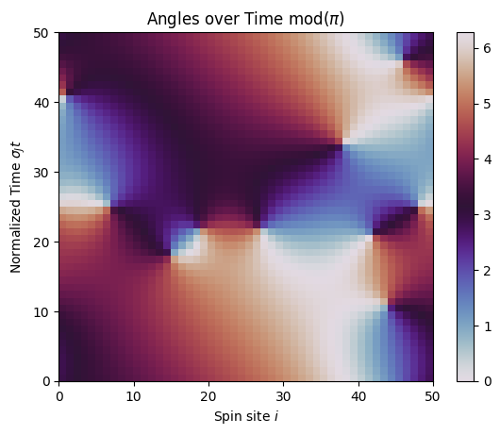
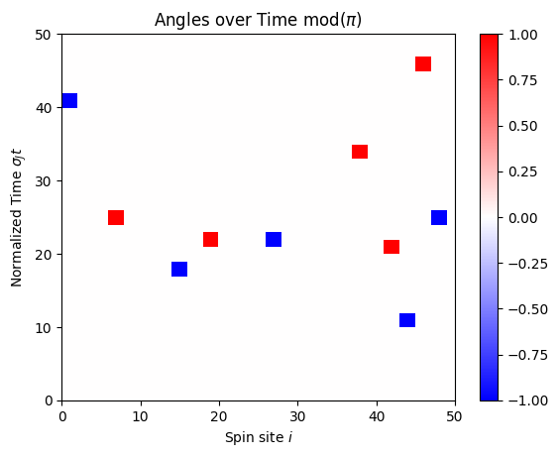

Slide 18
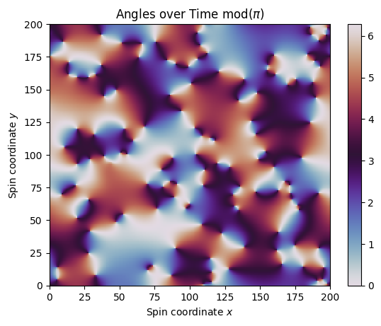
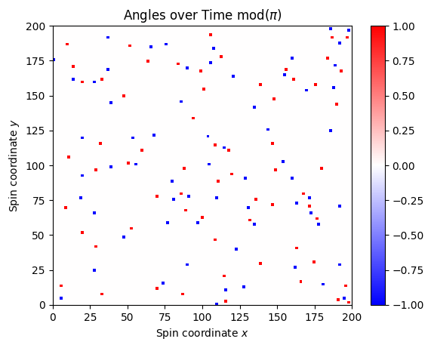

Slide 19






(a)
$$μ=0$$
$$μ=π/2$$
$$μ=π$$
(b)
XY Spin Angles, t=110
$$q=+1$$
$$q=−1$$

Slide 20




(c)
XY Spin Angles ($r=0, κ=0.4$) t=110
(a)
(b)

Slide 21





(a)
Typical Vortex Counts over time
($r=1, κ=0.4$)
(b)
Mean Vortex Density
(c)
Mean Charge Density

Slide 22





(a.2)
(a.1)
Mean Vortex Density $ρ$
(b)
Mean Charge Density $|Q|$
(a.3)
Typical Vortex Counts over time
($r=1, κ=0.4$)

Slide 23





(a.2)
(a.1)
Mean Vortex Density $ρ$
(b)
Mean Charge Density $|Q|$
(a.3)
Typical Vortex Counts over time
($r=1, κ=0.4$)

Slide 24


